Slide 1
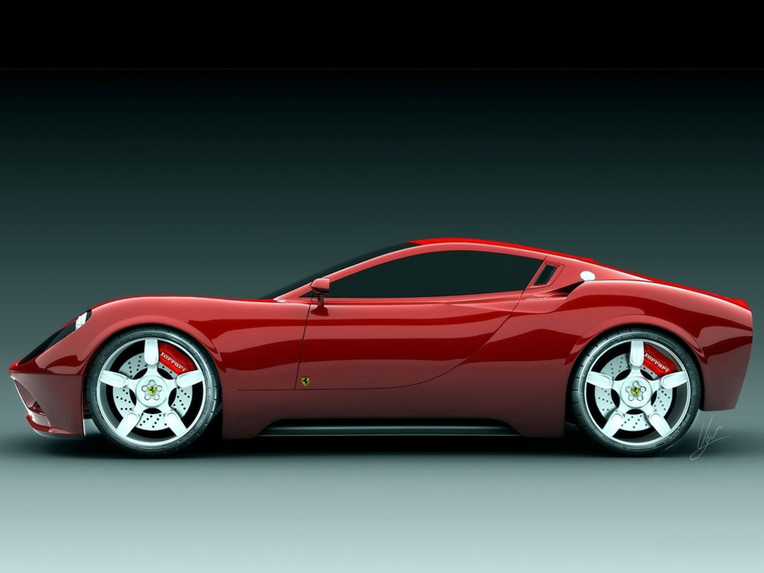
Car Price Prediction
Code Plateau 4.0 final project
By KARNAP BINSAK RIMVEN

Slide 2
Agenda:
Introduction
Data Collection
Data Cleaning
Exploratory Data Analysis
Prediction Modelling

Slide 3
Introduction
A Chinese automobile company aspires to enter the Nigerian market by setting up its manufacturing unit and producing cars locally to compete with their Nigerian, US and European counterparts.
They have contacted a Data Scientist to understand the factors on which the pricing of cars depends. Specifically, they want to understand the factors affecting the pricing of cars in the Nigerian market, since those may be very different from the Chinese market.
The company wants to know:
Which variables are significant in predicting the price of a car
How well do those variables describe the price of a car
Based on various market surveys, you have gathered a large data set of different types of cars across the Nigerian market.

Slide 4
Introduction
Problem statement
The goal of this project is for the chinese company to be able to know the estimated prices of cars in Nigeria
For the benefits of the Chinese company, a predictive analysis was carried out on a data set of different cars in Nigeria an estimation of what to be a good price to sell the car in the market

Slide 5
Introduction
Approach
A dataset was provided in a CSV format file as CarPrice_data.csv and then proceed to data cleaning and feature selection also once the data cleaning is done would want to understand how various features are been distributed and normalizing them
Developing a regression model in other to be able to predict the price of cars base on a model called the Linear Regression model and cross validating the result to find the best fit model for the car price prediction in case pf both train and test data

Slide 6
Data Collection
Different car listing prices collected across Nigeria
Extracting the Data with listing of 205 cars
Dataset having 26 columns :
(['car_ID', 'symboling', 'CarName', 'fueltype', 'aspiration', 'doornumber', 'carbody', 'drivewheel', 'enginelocation', 'wheelbase', 'carlength', 'carwidth', 'carheight', 'curbweight', 'enginetype', 'cylindernumber', 'enginesize', 'fuelsystem', 'boreratio', 'stroke', 'compressionratio', 'horsepower', 'peakrpm', 'citympg', 'highwaympg', 'price'],

Slide 7
Data Cleaning
After Extracting our data and checking for duplicate and NAN values it turns out to be that our data is actually clean with 0 duplicate and 0 NAN values
All the data types are good for analysis

Slide 8
Explotory Data Analysis
After clear Analysis of our data we observed the following:
10 columns with categorical values, 5 columns with int values and 7 columns with float.
Car with minimum price of 5118.000000 and with a maximum price of 45400.000000

Slide 9
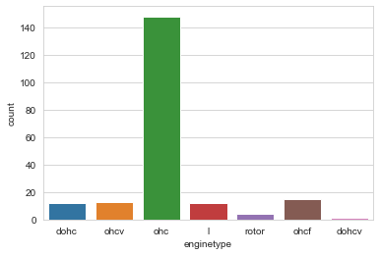
EDA
The graph clearly shows that the number of cars that use OHC has the highest number of engine type use by most of the cars

Slide 10
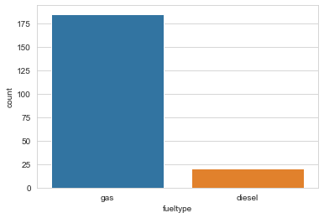
EDA
90% of the cars use GAS and just a few make use of Diesel

Slide 11
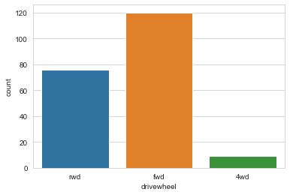
EDA
Most of the cars use FWD as drive follow by cars that make use of the NWD.

Slide 12
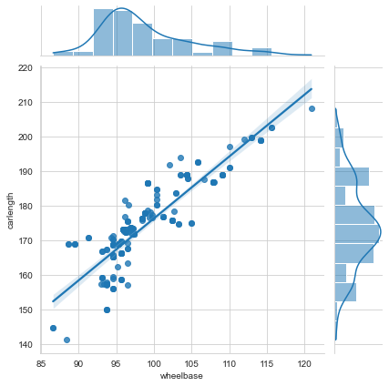
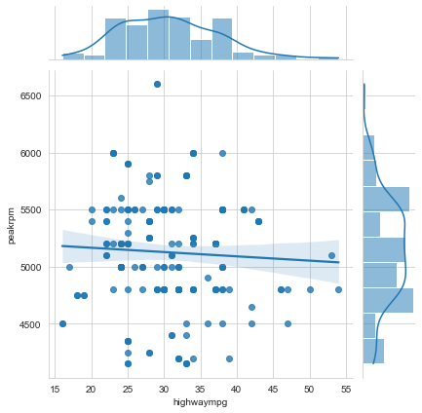
EDA
Highwaympg and peakrpn are negatively correlated with each other which implies that is not going to be good for our car prediction, they are inversely proportional to each other
From the joint plot we can clearly see that wheelbase is positively correlated with carlength which implies that they are directly proportional to each other therefore is good for our prediction

Slide 13
Prediction modelling
Linear Regression
Linear Regression
After splitting our data into Train and Test of the data, 70% of the data was use for training and 30% was use for the testing and we end up having a R squared Error : 0.9055938021998775 for the training and mean_absolute_error, mean_squared_error is MAE: 971.2636923076922 MSE: 1437908.4721399578
And test was carried out after the training of the data set and we end up having the R squared Error as: 0.7705201375662581 and mean_absolute_error, mean_squared_erro
MAE: 2432.3905419726552 MSE: 10748212.57584067

Slide 14

Conclusion
Using LinearRegression in the prediction of the car price didn’t really shows much difference in the price compared to the actual prices of the car in the dataset

